Slide 1

Inventory Risk & Forecasting Review
Notes:
This presentation addresses inventory vulnerabilities, forecasting gaps, cost efficiency by product category, and EOQ insights across SKUs.

Slide 2

Shiseido Overview
Dynamic Executive Dashboard

Slide 3

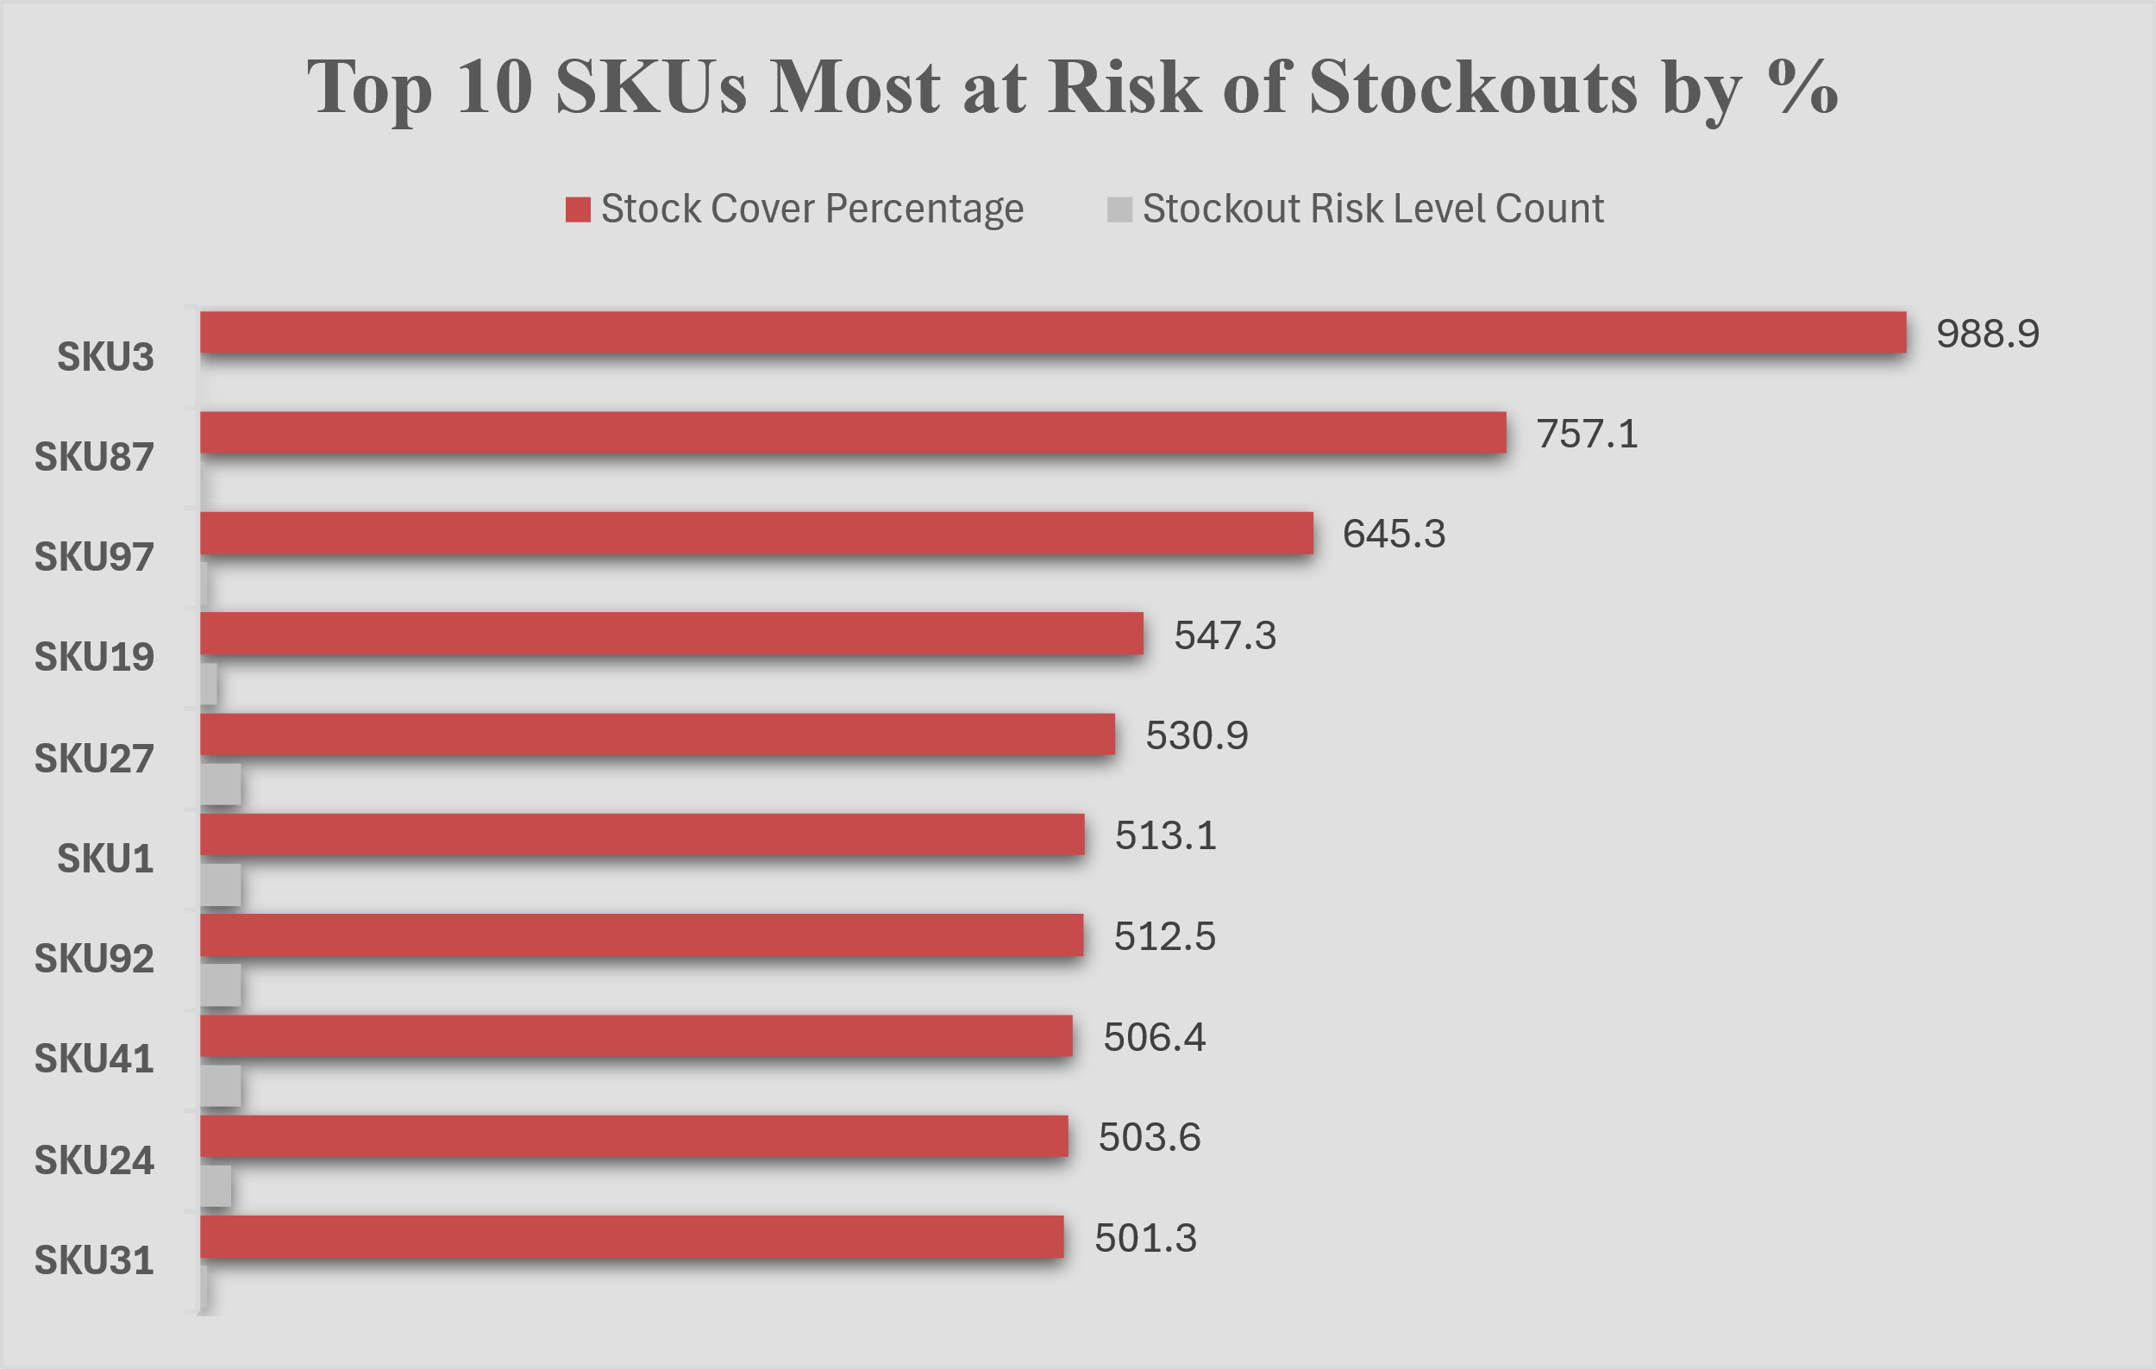
SKUs at Risk
"SKU3, SKU87, and SKU97 currently show excessively high stock coverage despite minimal stockout risk, suggesting overstocking or conservative replenishment thresholds. These SKUs may be candidates for inventory right-sizing to reduce carrying costs without compromising service levels."
Notes:
These SKUs are holding more inventory than needed based on recent demand.

Slide 4
Average Forecast Error Rate by Product Type and Region
Average of Forecast Error Rate
 | Bangalore | Chennai | Delhi | Kolkata | Mumbai | Grand Total
cosmetics | 10.24% | 10.12% | 10.06% | 10.04% | 10.00% | 10.09%
haircare | 10.00% | 10.10% | 10.04% | 10.02% | 10.12% | 10.05%
skincare | 10.00% | 10.00% | 10.16% | 10.00% | 10.00% | 10.03%
Grand Total | 10.08% | 10.07% | 10.08% | 10.02% | 10.04% | 10.06%
“Cosmetics in Bangalore shows the highest forecast error rate (10.24%), indicating a need for model adjustment. Skincare remains the most stable across regions.”
Notes:
Delhi and Mumbai have Slightly Higher Error Rates.
Particularly for skincare in Delhi (10.16%) and haircare in Mumbai (10.12%).
These could be reviewed for potential over-forecasting or under-forecasting bias.

Slide 5

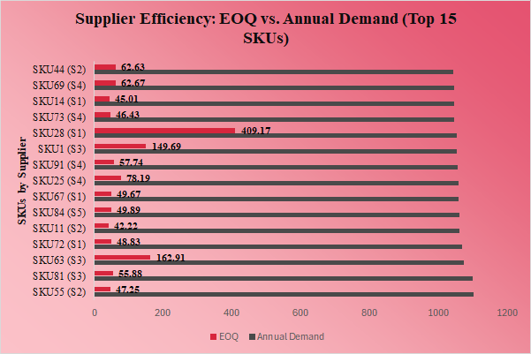
Supplier EOQ vs Demand Analysis
SKU28 (S1) shows a disproportionately high EOQ (409.17 units), indicating either batch-heavy ordering behavior or a misalignment in replenishment logic.
On the other hand, several SKUs like SKU44 (S2) and SKU69 (S4) maintain tight EOQ-to-demand ratios, reflecting efficient inventory planning.
Notes:
“These comparisons spotlight where suppliers may benefit from right-sizing EOQ to reduce costs while maintaining service levels.”

Slide 6

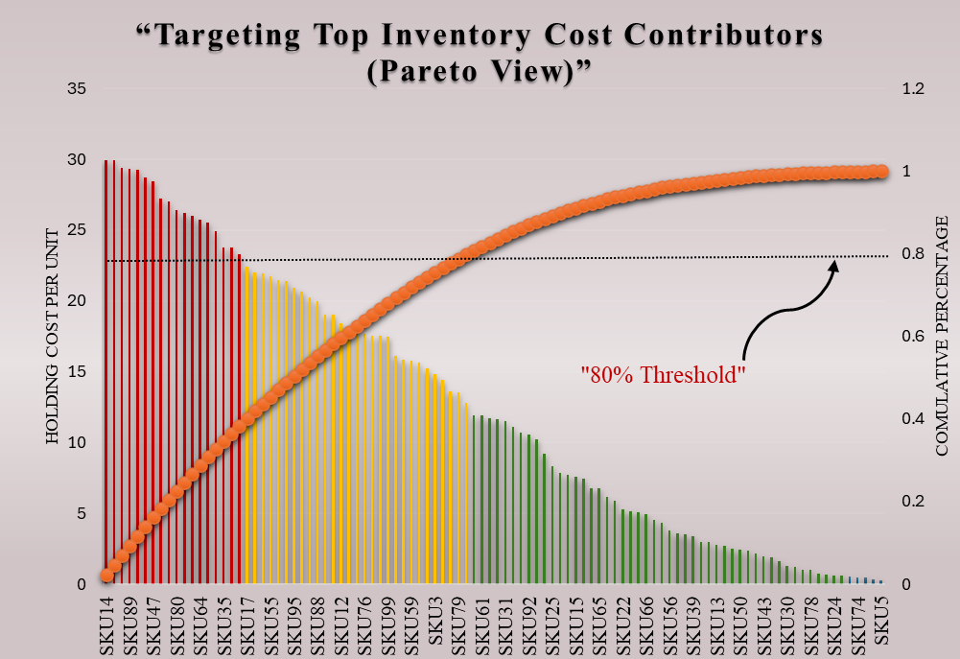
"Prioritizing SKUs Driving Holding Cost Disparity"
The red bars represent the top 10 SKUs, which contribute to over 80% of cumulative holding costs, identifying them as high-impact, cost-intensive inventory.
Notes:
Although this view doesn’t group SKUs by product type (e.g., skincare, cosmetics), it highlights which SKUs to prioritize within each category for cost control, cycle count frequency, or right-sizing inventory levels.

Slide 7

"Dead Stock Prioritization by Overstock and Reorder Sensitivity"
“This slide pinpoints dead stock risks like SKU8 and SKU61, which have not sold in over 7 months yet carry 600+ units in excess. Their bubble size shows high overstock far above reorder point thresholds. We can recommend liquidation or markdown strategies for these SKUs to reduce holding cost exposure. Others like SKU3 have smaller gaps, indicating better demand alignment.”
Notes:
“This chart classifies SKUs by inventory surplus vs. last sale date.”
SKU8 and SKU61 are high-risk dead stock with excess units and no recent movement.
SKU64 and SKU87 are mid-risk—slowing but salvageable.
SKU3, though recently sold, already shows early signs of surplus, flagging a forecasting imbalance.
“This visual lets us prioritize clearance, forecast corrections, or reorder suspensions.”

Slide 8

"Inventory Optimization Recommendations"
1. Clear Excess from Aged SKUs
SKU8 and SKU49 should be prioritized for markdowns, clearance, or discontinuation due to prolonged inactivity and high overstock.
2. Tighten Forecasting Logic for Active SKUs
SKUs like SKU61 and SKU3 reflect over-replenishment despite recent sales. Improve reorder trigger precision using demand forecasting models (e.g. exponential smoothing, XGBoost).
3. Monitor Near-Risk Inventory
SKU64 and SKU97 are still active but approaching dormancy. Use stock-to-sales ratio tracking to prevent escalation.
4. Implement ROP-Based Inventory Alerts
Use reorder point logic (ROP = avg. daily demand × lead time) to automate alerting for understock, on-target, or overstock states across SKUs.
5. Align Supply Chain to SKU Behavior
Incorporate Last Sold Date and surplus thresholds into your inventory planning dashboards to anticipate and avoid future dead stock.
Notes:
Effective inventory optimization requires accurate demand forecasting to ensure stock levels meet customer needs. Implementing automated inventory management systems can reduce human error and improve efficiency. Regularly reviewing and adjusting reorder points and safety stock levels based on sales data helps maintain optimal inventory levels, preventing both overstock and stockouts.

